Slide 1

Analyzing Customer Churn in Telecom Company
Machine Learning Project
Done by:
Basava Sanketh BN

Slide 2

Agenda
Introduction
Problem Statement
Data Collection
Exploratory Data Analysis
Data visualisation
Model building
Model Evaluation
Conclusion

Slide 3

Introduction
Telecom companies are facing a huge challenge as customers are leaving due to certain reasons.
To identify the causes of customer churn, analysis of the company's dataset is necessary.
This presentation will focus on the analysis of the telco-customer-churn dataset from Kaggle and finding the reason for the loss of customers.
The dataset contains information about customer demographics, tenure, contract type, and monthly charges.
Various methods such as exploratory data analysis, data visualization, and machine learning algorithms will be used to analyze the data and draw meaningful insights.

Slide 4

Aim and Problem Statement
Aim: The aim of this project is to perform analysis on the dataset provided by a telecom company, which is experiencing customer churn, and identify the reasons for the loss of customers.
Problem Statement: The telecom company is facing a customer churn, which is adversely affecting its business. The company wants to identify the root causes of customer churn and take appropriate measures to retain its customers.

Slide 5

Data Collection
We have got dataset from the Kaggle
https://www.kaggle.com/datasets/blastchar/telco-customer-churn
This dataset consists of 21 columns and 7,043 rows

Slide 6

EDA
Checking for missing and duplicates values
Done Feature engineering
Done Feature scaling (Standard Scaler)

Slide 7
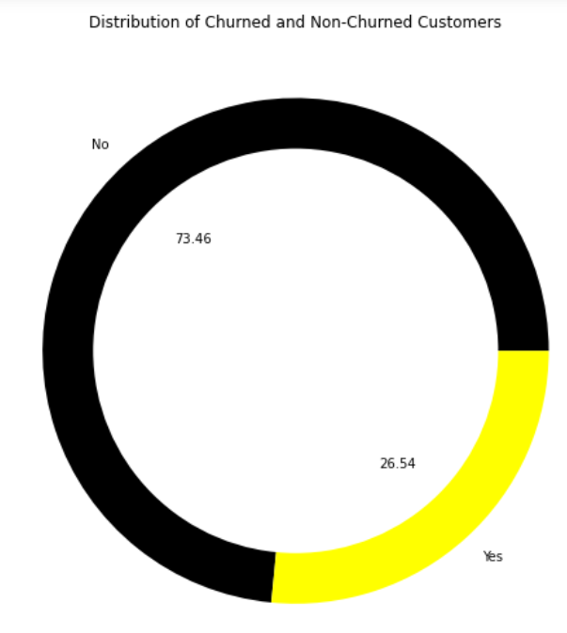
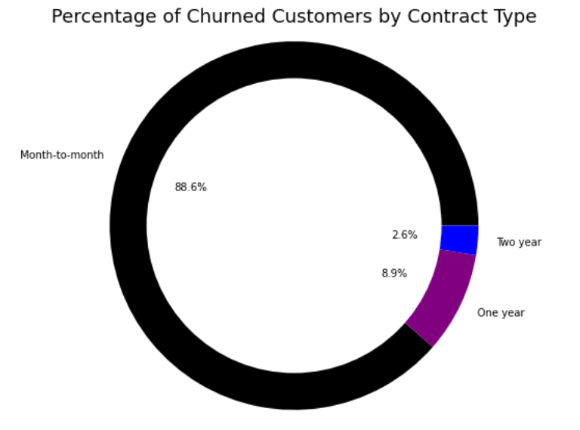
Data visualisation

Slide 8
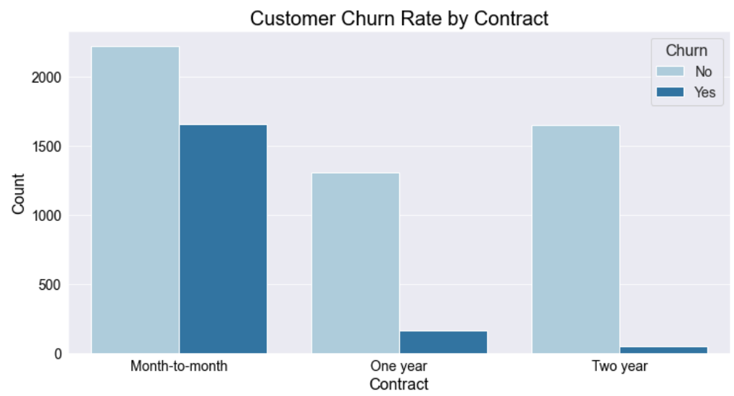
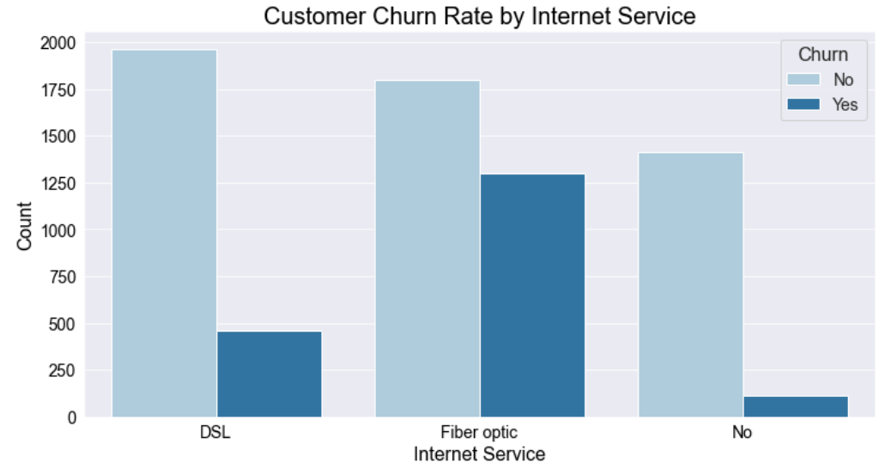
Data visualisation

Slide 9
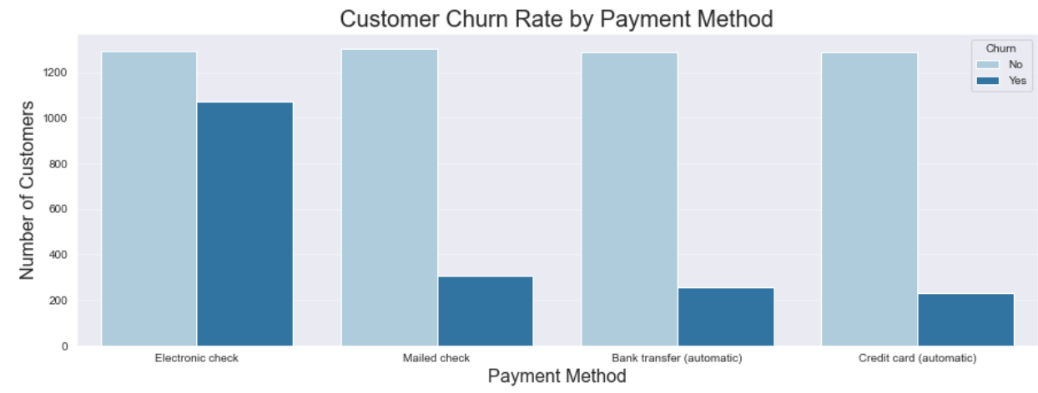
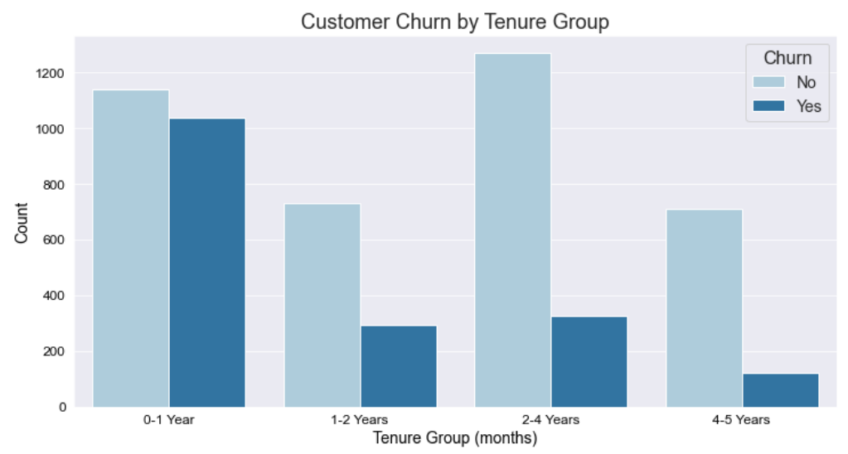
Data visualisation

Slide 10
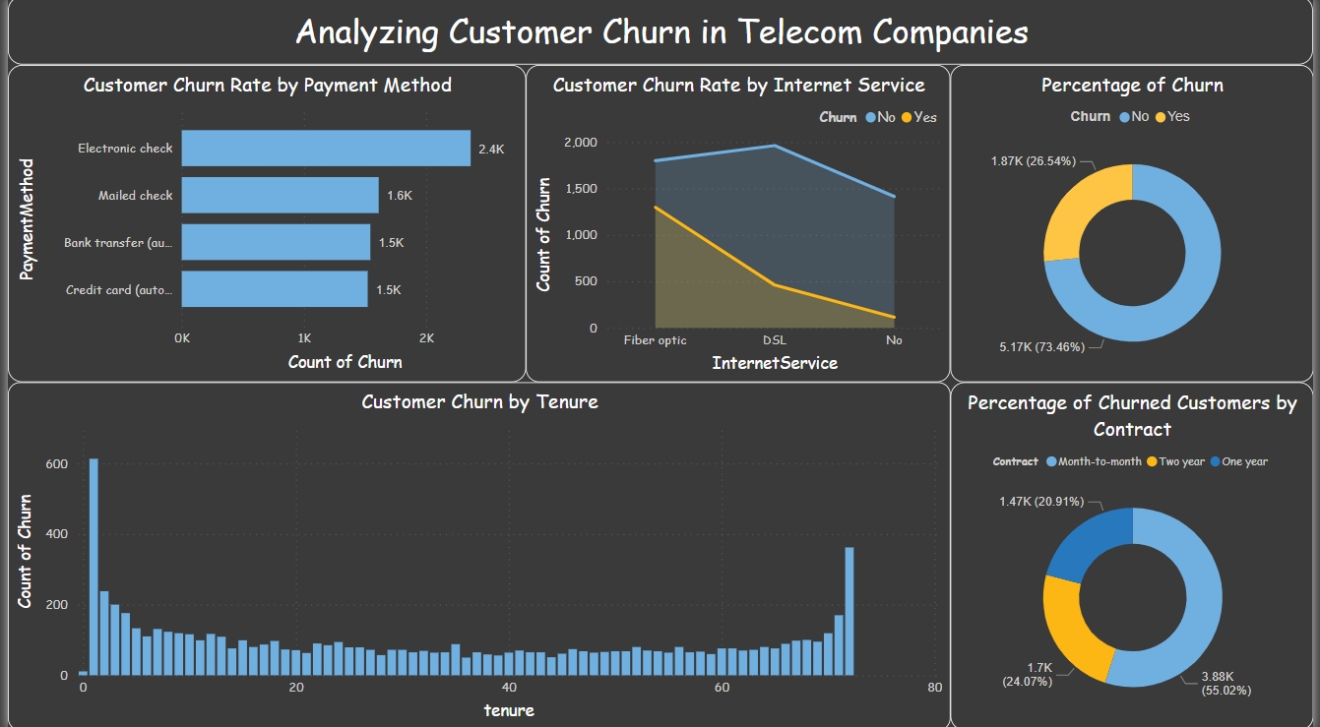
Data visualisation

Slide 11

Model building
Machine learning algorithms are powerful tools for analyzing data.
In this project, machine learning algorithms will be used to analyze the data and identify patterns and trends that could explain customer churn.
Various algorithms such as logistic regression, decision trees, SVM, and random forests will be used to build models that can predict customer churn.
The models will be evaluated using various metrics such as accuracy, precision, and recall.
Then I have trained models and finally selected the best model (logistic regression)

Slide 12
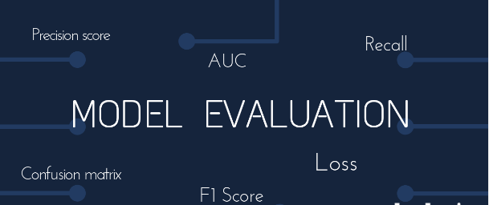
Model Evaluation
Evaluating the models performance using metrics such as accuracy, precision and recall.
Interpreting the results and providing insights on the reasons for customer churn.

Slide 13
Conclusion
After running the code, we obtain the Accuracy, precision and Recall scores of all the models. We can then choose the best model to make predictions on new data.
From the data visualization, we can see that the customers who have opted for a shorter contract period have a higher churn rate. Similarly, customers who have opted for fiber optic internet service and electronic check payment method also have a higher churn rate. On the other hand, customers who have opted for a longer contract period and automatic payment method have a lower churn rate
Some of the potential factors that could be contributing to customer churn in a telecom company include:
Poor customer service or support
High prices or billing issues
Network quality or coverage issues
Limited service or product offerings
Contract or commitment terms
Based on the results of the machine learning models, the Logistic regression performs the best with an accuracy score of 81.7%
In conclusion, the telecom company can reduce the customer churn rate by offering longer contract periods, improving the quality of the fiber optic internet service, and providing more convenient payment methods in electronic check. The Logistic regression model can be used to predict which customers are likely to churn and offer them incentives or discounts to retain them

Slide 14


